Slide 1

AMAZON
Sentiment Analysis of Product Reviews
by Annisa Dzikra Salma

Slide 2
Table of Content
01
Background & Project Overview
02
Data Understanding & Preprocessing
03
Exploratory Data Analysis
04
Text Processing
RATING
05
Modeling
06
Conclusion & Recommendation

Slide 3
Background
RATING
Amazon
company released various products like the Kindle, Fire TV, etc. This dataset consists of over 20,000 reviews of Amazon products. This dataset includes basic product information, rating, review text, and more for each product.

Slide 4
Project Overview
Goal
Dataset
Identify and analyze consumer sentiments on Amazon products reviews
Subset of the Amazon Product Reviews dataset from Kaggle.
SERVICES

Slide 5
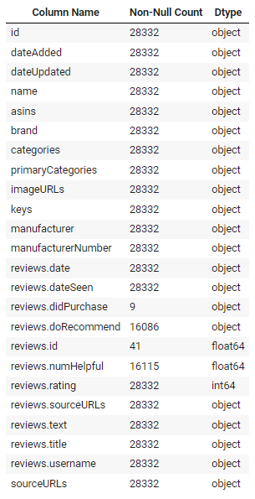
Data Understanding & Preprocessing
Name of products
Rating of Products
E-COMMERCE CHANNEL SALES
Text review of products
Tittle review of products (more concise than reviews.text)

Slide 6
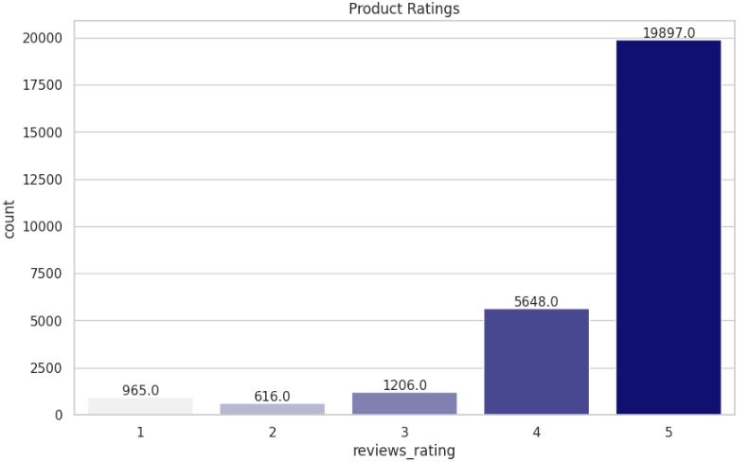
EDA : Product Ratings
01
Most of the customer rating is 5.

Slide 7
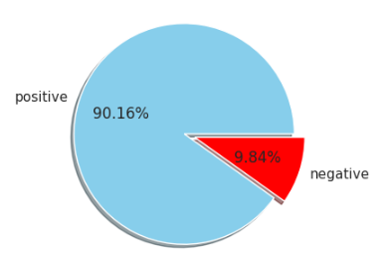
EDA : Pie Chart of Product Ratings
02
We classify positive (rating 4 & 5) and negative (rating 3 & 2 & 1) reviews : 90.16% positive and 9.84% negative.

Slide 8
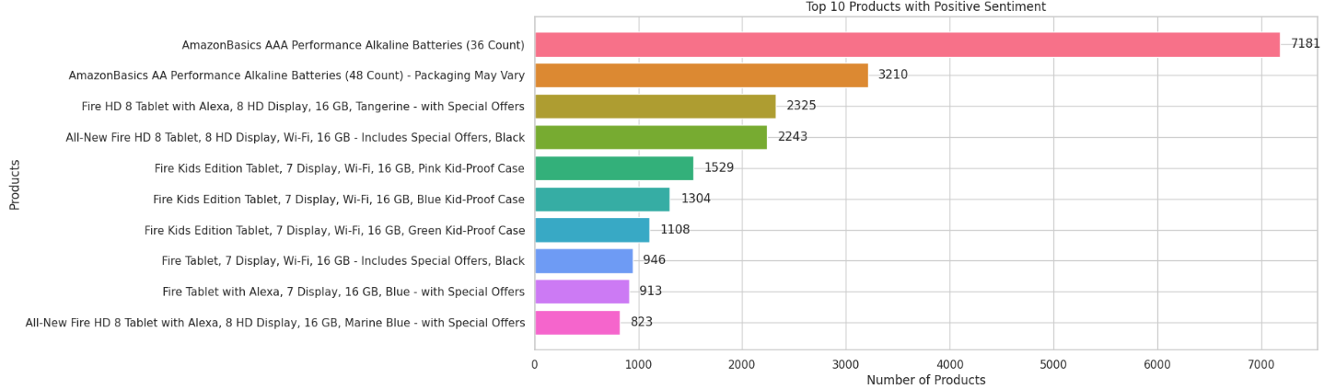
EDA : Top 10 Products with Positive Sentiment
03
Favorite product with positive sentiment :
AmazonBasics AAA Performance Alkaline Batteries (36 Count).

Slide 9
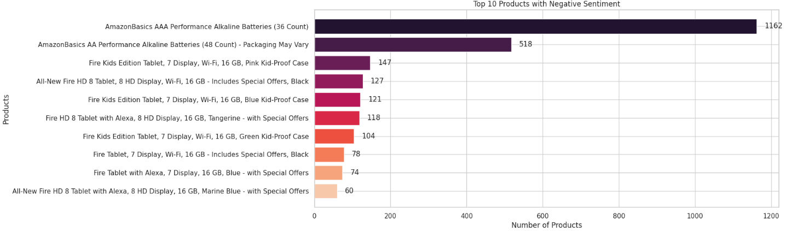
EDA : Top 10 Products with Negative Sentiment
04
Favorite product with negative sentiment is same with the positive sentiment :
AmazonBasics AAA Performance Alkaline Batteries (36 Count).

Slide 10
Text Processing
EDA : WorldCloud
05
Before
Great tablet for kids
1. Remove links
2. Remove hyperlinks and markups
3. Unify whitespaces
5. Remove non-alphabetic characters using regular expression
6. Remove punctuation, convert to lowercase
7. Join the characters again to form the string
8. Remove stop words using ntlk library
9. Remove non-sensical words (troll messages) defined as having more
10. Check if text is empty after cleaning
After
great tablet kids

Slide 11
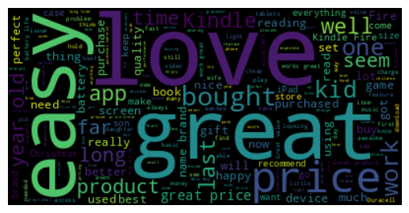
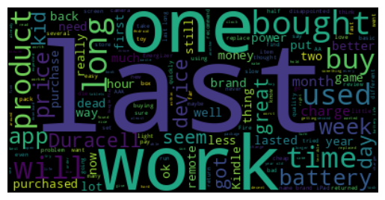
WorldCloud (After Text Processing)
Positive Reviews
Negative Reviews
love, great, easy, price
last, one, work, long

Slide 12
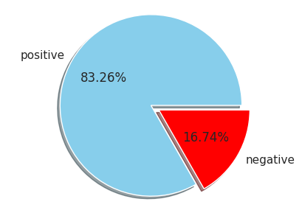
EDA : Sentiment of Text Review
06
We classify sentiment from text review (after text processing) using TextBlob: 83.26% positive and 16.74% negative.

Slide 13
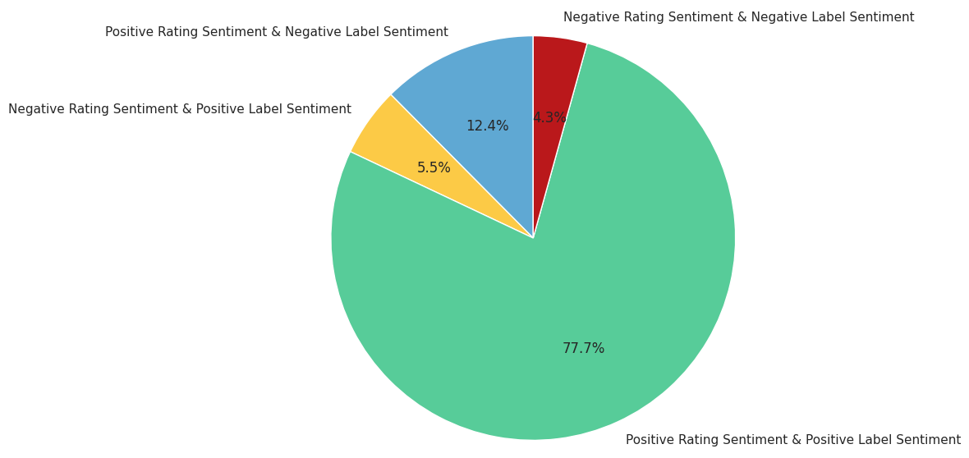
EDA : Sentiment from Rating and Text Review
07
How does sentiment analysis compare from ratings and text reviews?

Slide 14
Modeling : with Bag of Words
F1-Score 1 (%)
ROC AUC Score (%)
99
99.14
93
93.07
98
95.40
We create model using text review (after processing) and sentiment of text review.
F1-Score
-1 (%)
Logistic Regression + BoW
93
Multinomial Naive Bayes + BoW
47
Decision Tree Classifier + BoW
92
MLP Classifier + BoW
93
99
98.83
SGD Classifier + BoW
94
99
N/A
Logistic Regression+ BoW performs the best

Slide 15
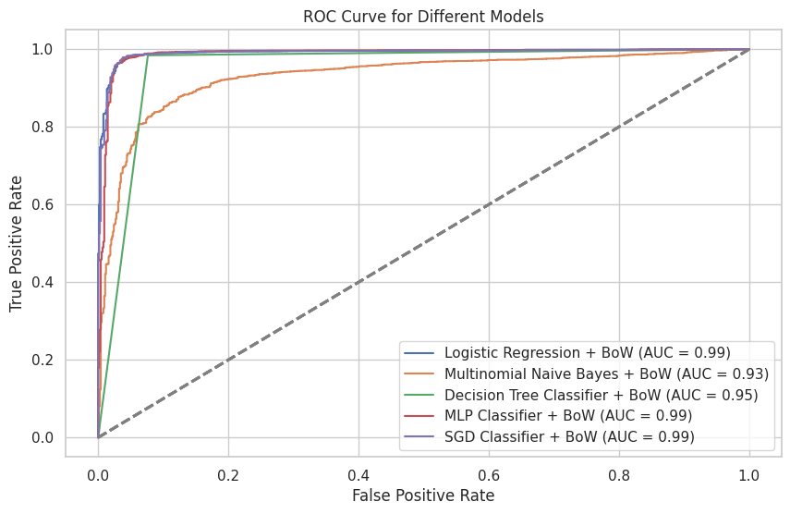
ROC Curve for Different Models
Logistic Regression+ BoW performs the best

Slide 16
Modeling : with TFIDF Vectorizer
F1-Score -1 (%)
F1-Score 1 (%)
ROC AUC Score (%)
84
97
98.88
09
91
94.09
92
98
95.17
We create model using text review (after processing) and sentiment of text review.
Logistic Regression + TFIDF
Multinomial Naive Bayes + TFIDF
Decision Tree Classifier + TFIDF
MLP Classifier + TFIDF
91
98
88.63
SGD Classifier + TFIDF
90
98
N/A
Logistic Regression + TFIDF performs the best

Slide 17
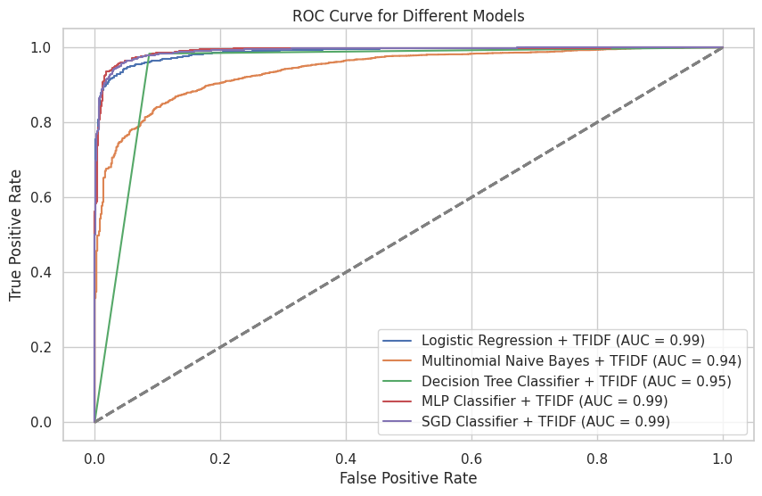
ROC Curve for Different Models
Logistic Regression+ BoW performs the best

Slide 18
Conclusions
The models show good performance in predicting sentiment on Amazon product reviews. In general, the models achieved high accuracy, with most accuracies above 94%.
The Logistic Regression obtained quite high F1-Score and ROC AUC Score values, indicating the model's ability to classify sentiment in a balanced manner between precision and recall, as well as the ability to separate positive and negative classes.
Using Bag of Words or Count Vectorizer and TFIDF Vectorizer show high results.
Priority : higher accuracy -> BoW model
Priorities : dealing with word frequency, and/or prioritize computing time -> TFIDF model
Most product reviews have positive sentiment, characterized by high accuracy values and F1-Scores for the positive class. This shows that the majority of Amazon customers have a good experience with the products they have reviewed.

Slide 19
Recommendations
Logistic Regression as the main model for Amazon product sentiment analysis.
Company can use the best models that have been developed to monitor consumer sentiment towards their products in real-time.
Company is advised to further analyze the differences between customer’s rating and text review of product.
Rating 4 / 5 with negative sentiment of text review or
Rating 1 / 2 / 3 with positive sentiment of text review.

Slide 20




Contact Me
+62 89 525 825 557
annisads98@gmail.com
linkedin.com/in/annisa-dzikra-salma-311812124
github.com/annisads98

